Slide 1

Motivating Students:
Seven Research-Based Strategies
Sarah Leupen
Neuroscience in Education Conference, April 2017

Slide 2
Co si myslíte, že by mě nejvíce motivovalo ke studiu češtiny během mého pobytu v Plzni? Proč?
a) "Je skvělé, že jste se naučila pár frází, než jste přijela! Jsem si jistý, že se naučíte další slova v průběhu pobytu. Ozvěte se, pokud byste potřebovala poradit.“
b) „Čeština je náročná, ale musíte se ji naučit, protože moc lidí v Plzni anglicky nemluví. Tady máte nějaké učebnice gramatiky.“
c) „Čeština je náročná, ale dá se naučit. Jsou Vám k dispozici týdenní konverzační lekce a ve čtvrtek se můžete také vzájemně doučovat češtinu a angličtinu s mým manželem Petrem.“
d) "Čeština není tak náročná - je možné se ji naučit - ale všichni chtějí stejně mluvit anglicky, tak jaký má smysl učit se česky jeden rok?"

Slide 3
HIGH
Defensiveness,
Retreat
Growth,
Learning
Challenge
No change
(I don’t need to understand)
Confirmation
(My current understanding is sufficient)
LOW
LOW
Support
HIGH
Modified from Daloz, L., Effective Teaching and Mentoring, 1986 (214)

Slide 4
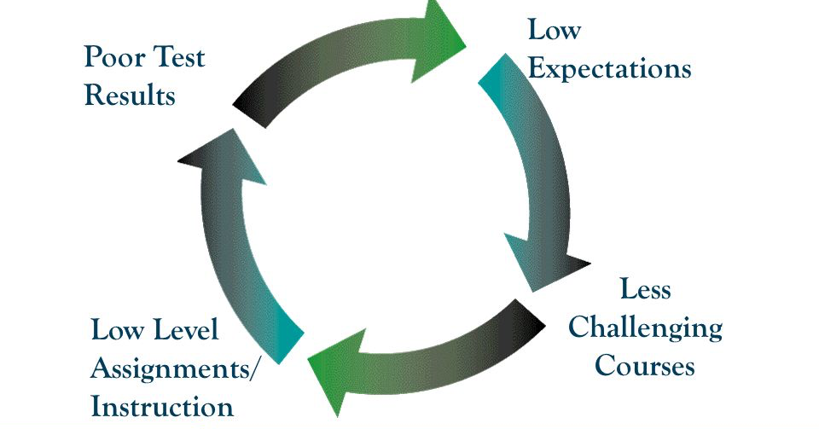
The Vicious Cycle of Low Expectations

Slide 5
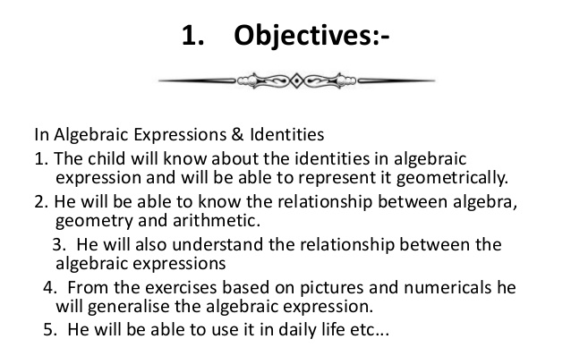
1. Give Students High and Specific Expectations
Poorly written objectives

Slide 6
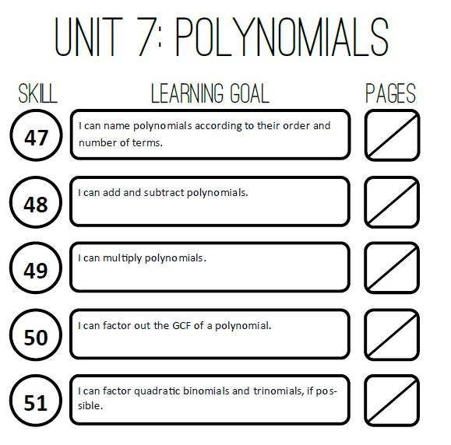
1. Give Students High and Specific Expectations
Well written objectives

Slide 7
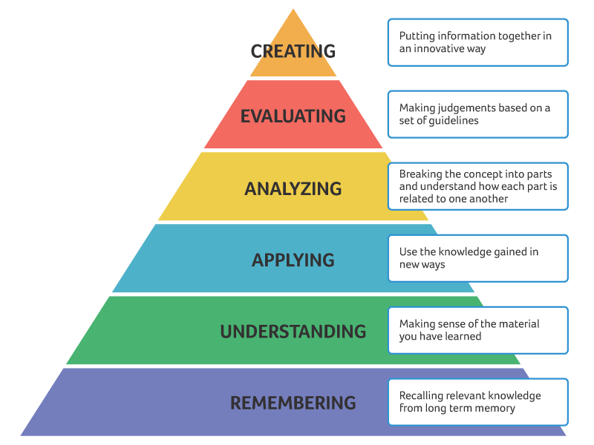
Bloom’s Taxonomy Bloomova Taxonomie
Notes:
2014 study, chemistry

Slide 8
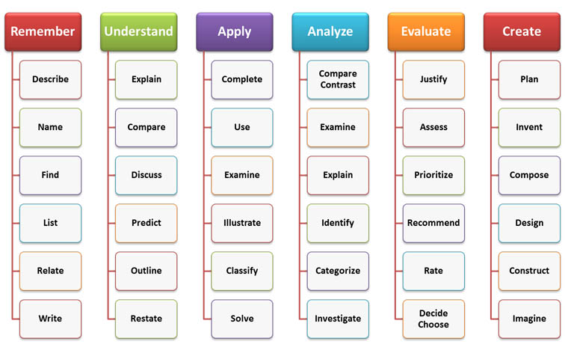
“Bloom’s Verbs” to help you write goals

Slide 9
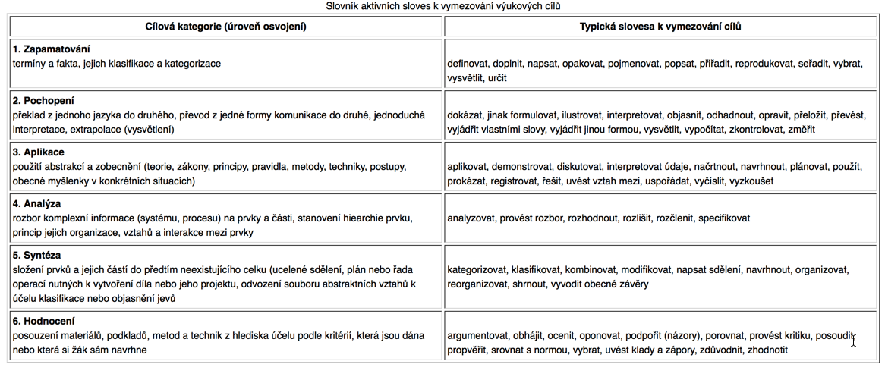
Slovník aktivních sloves k vymezování výukových cílů
http://wiki.ped.muni.cz/index.php?title=Bloomova_taxonomie_výukových_c%C3%ADlů

Slide 10
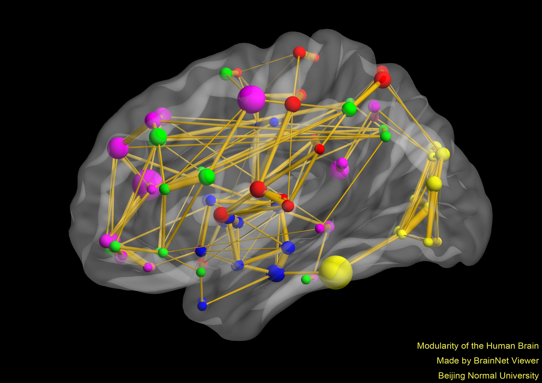
2. Expect and Reward Preparation for Class
Make your class’ module louder!
By Mingrui Xia from data in He, et al. 2009 Plos One

Slide 11
Reading Responses
A General
Reading Response

Slide 12
Reading Responses
A Specific
Reading Response

Slide 13
3. Pomozte jim naučit se učit
Co studenti vlastně dělají, když se učí na Vaše hodiny?
Opakovaně čtou materiály, které od Vás dostali
Dívají se na úkoly a skupinové práce, které jste na téma zadali.
Řeší praktické problémy a odpovídají na zadané otázky
Snaží se látku vysvětlit jiné osobě
Sledují na internetu videa o dané látce

Slide 14
3. Help them Learn How to Learn
Tell Your Students:
Don’t study only by reading, especially re-reading!
Ask questions as you study, and see if you can answer them
Try to teach someone else the topic
Avoid media and distractions while studying
Space out your studying over time
Notes:
12 year old math students at a middle school in Florida

Slide 15
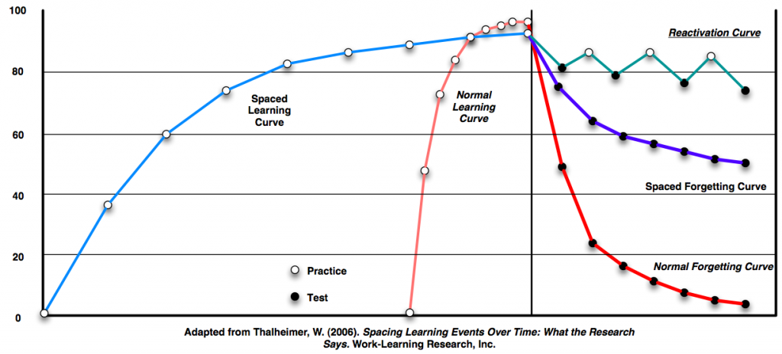
Spaced Practice Improves Retention

Slide 16
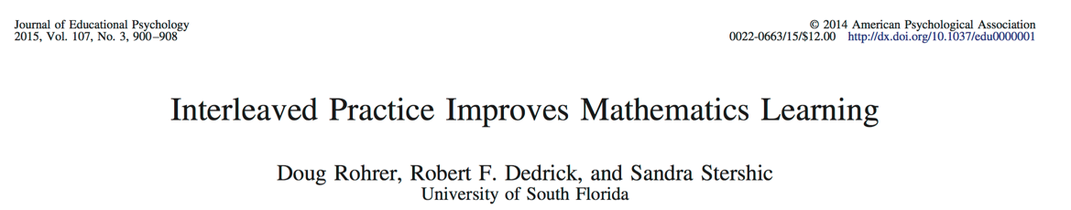
4. Interleave your lessons
Notes:
12 year old math students at a middle school in Florida

Slide 17
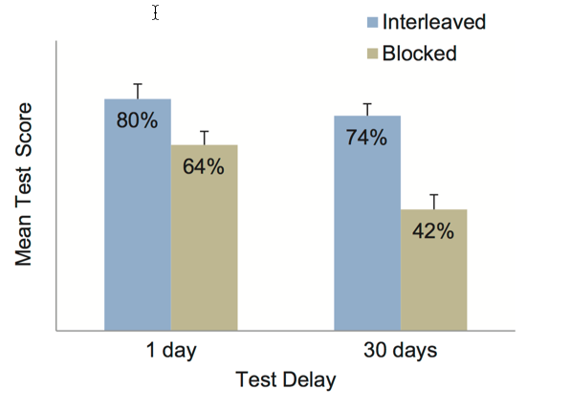
4. Interleave your lessons
Notes:
12 year old math students at a middle school in Florida

Slide 18
4. Interleave your lessons
Why?
With blocking, you can hold a single strategy temporarily in short-term memory
With interleaving the correct solution changes with each practice attempt
So the brain is continually engaged at retrieving different responses
This reinforces neural connections between different tasks and correct responses– which is increased learning!
Notes:
12 year old math students at a middle school in Florida

Slide 19
5. Make Student Participation and Activity Part of Every Class
Use the Minute Paper

Slide 20
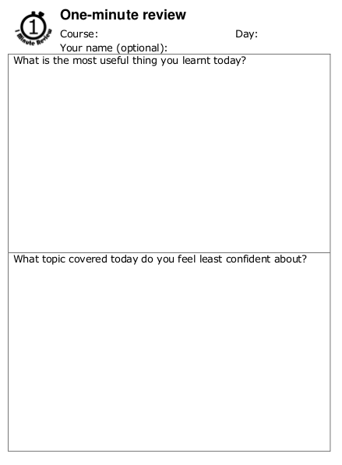
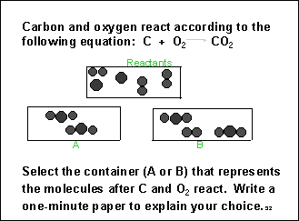
The Minute Paper

Slide 21
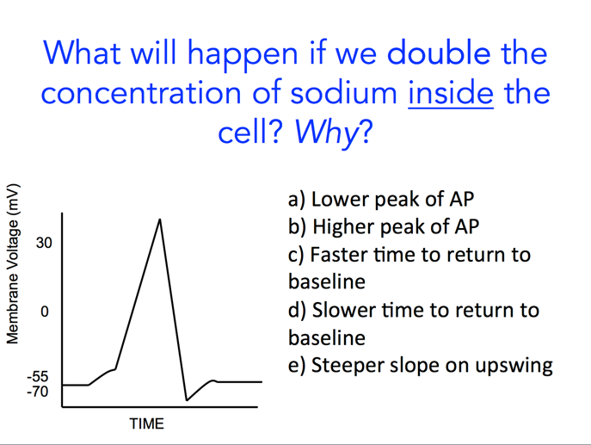
5. Make Student Participation and Activity Part of Every Class
Minute Paper
Ask “thinking” (conceptual) questions; have students talk to each other first, then respond

Slide 22
5. Make Student Participation and Activity Part of Every Class
Minute Paper/ Muddiest Point
Ask “thinking”questions
Call on individuals

Slide 23
6. Assess Student Understanding More Frequently

Slide 24
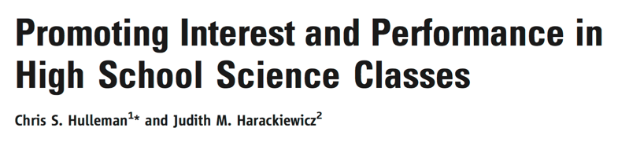
7. Connect your content to the “Real World”
High school science students were asked to either write about the “relevance of the class material in their own lives” or to write a summary of the material
Teachers did not know which group students were in
At the end of the year, interest in science and grades were measured

Slide 25

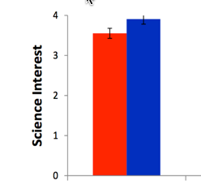
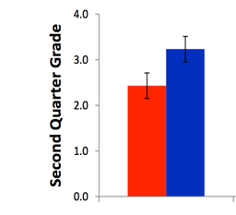

Slide 26
What are the most common dietary sources of vitamin K?
Nuts, seeds and whole grains
Dairy products including milk and cheese
Leafy greens such as spinach
Meats, especially pork, and kidney beans

Slide 27
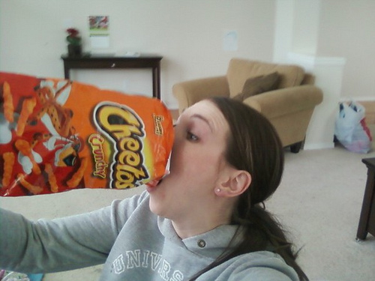
Your sister eats only fast food and processed carbohydrates. Which fat soluble vitamin is she most likely to be deficient in?
A
D
E
K

Slide 28
Messages to Students:
This is a difficult topic. You will need to work hard to understand it.
I want you to understand this topic. I think you can understand this topic. I will help you.
But I can’t put knowledge in your head. Learning is hard work.

Slide 29
The Virtuous Cycle of High Expectations
High Expectations and High Support
High Student Performance
Improved Student Behaviors
Higher Level Assignments/Instruction

Slide 30
